Slide 1
机器学习 遥感数字图像处理

Slide 2
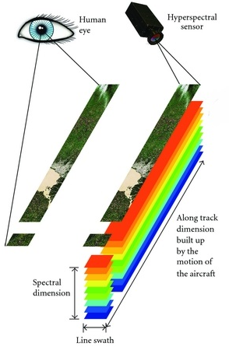
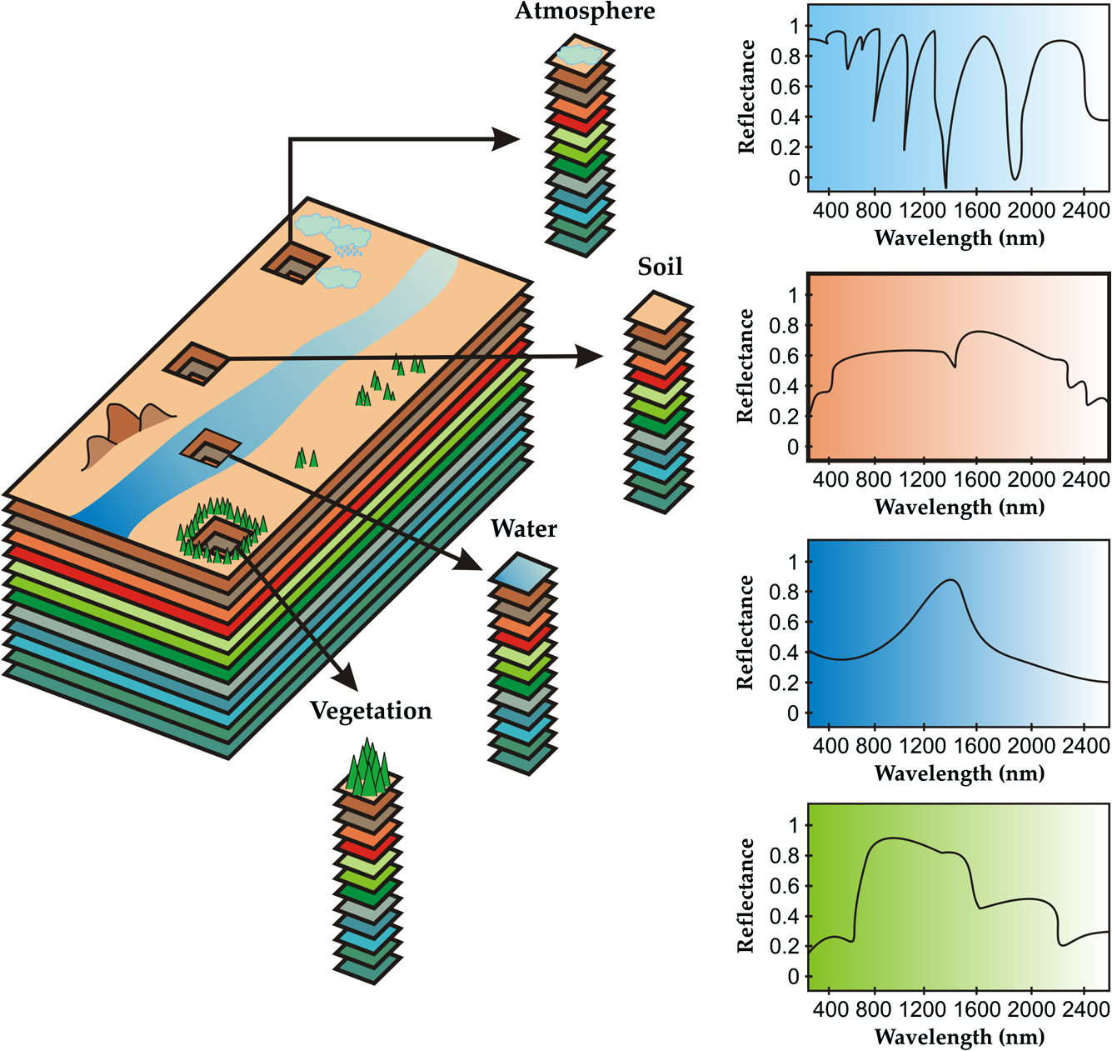
高光谱遥感影像
不同地物对应不同波谱曲线，可用于地物分类

Slide 3
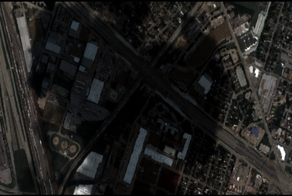
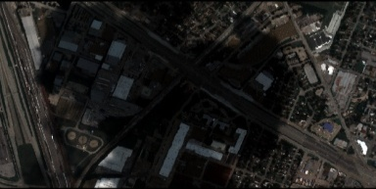

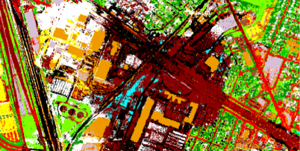
遥感图像特征提取与分类
研究技术路线：
遥感图像
特征信息
分类结果图
研究课题目标：
高光谱图像降维，减少计算量、存储空间和传输时间;
提取易判别的特征信息;
分类识别，提高分类精度;

Slide 4
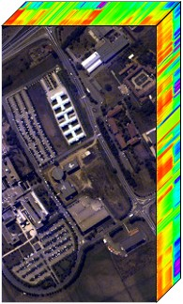
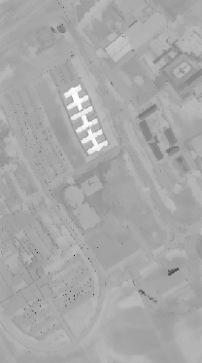
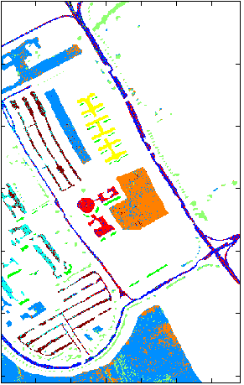
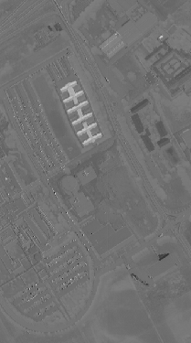
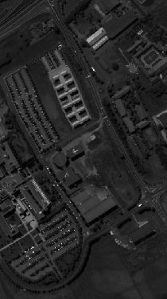
特征提取
D 波段
d 波段
D>>d
特征提取
降维
分类
HSI
分类结果图
低维特征

Slide 5
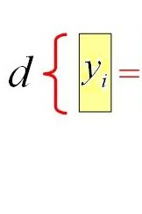
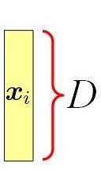
Linear feature extraction
高维样本点:
提取低维特征:
转换矩阵:
找到最优投影矩阵W

Slide 6
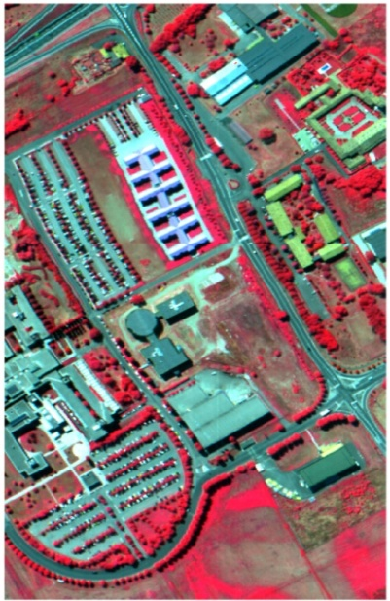
Experiments
数据集:
UPavia
610x340x109
KSC
512x614x176
1.3 m/pixel
18 m/pixel
分类器: k-nearest neighbors (k-NN);
Support Vector Machine (SVM);
Random Forest (RF)

Slide 7
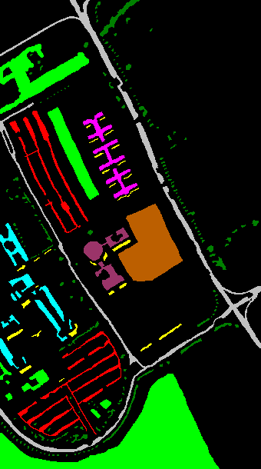
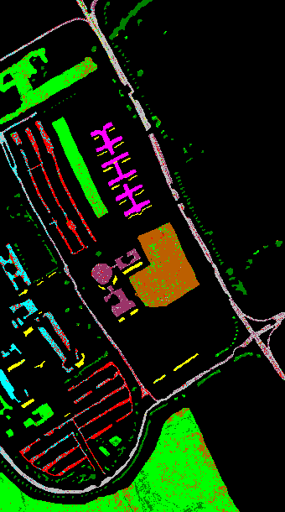
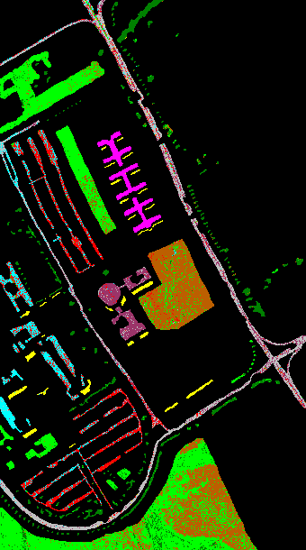


Groundtruth
Proposed (OA=81.2%)
PCA (OA=69.5%)
NWFE (OA=73.3%)
Liao (OA=79.1%)
Classification maps of different methods for University of Pavia

Slide 8
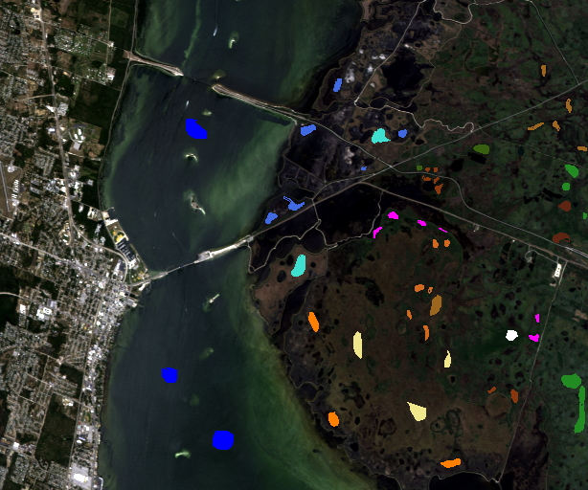
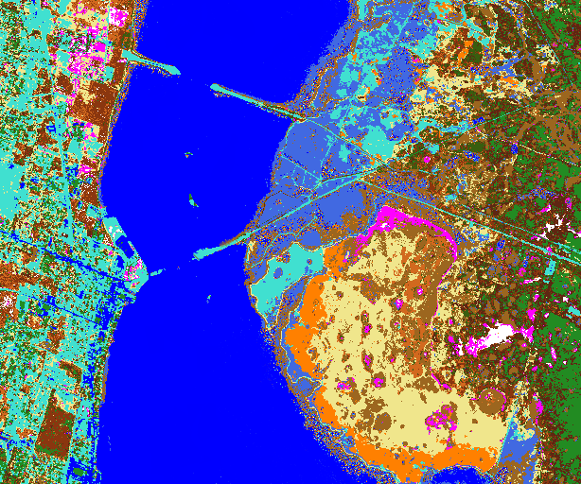
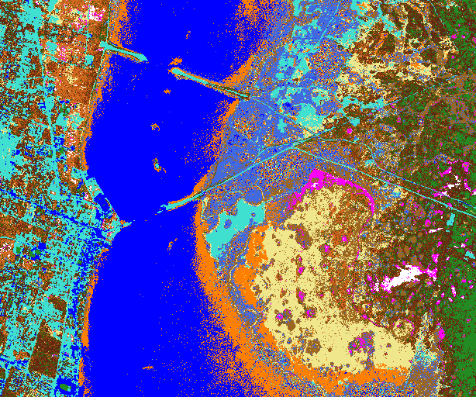
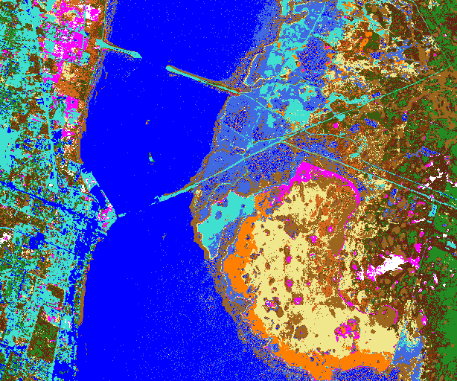

RGB and Groundtruth
Proposed (OA=93.0%)
PCA (OA=81.4%)
NWFE (OA=87.7%)
Liao (OA=91.1%)

Slide 9
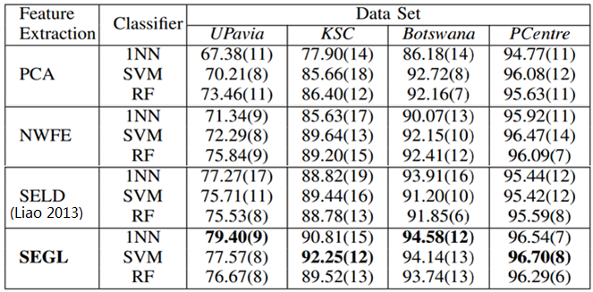
Experimental results
Classification accuracy (%) with 20
training samples per class

Slide 10
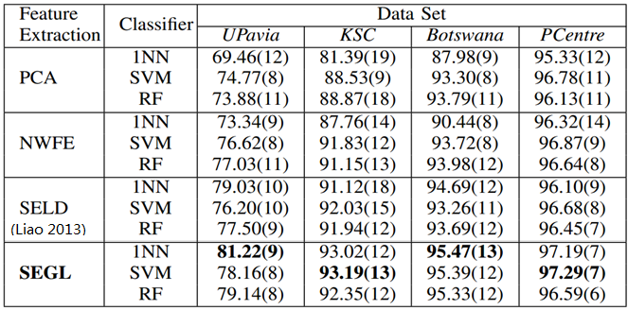
Experimental results
Classification accuracy (%) with 40
training samples per class

Slide 11
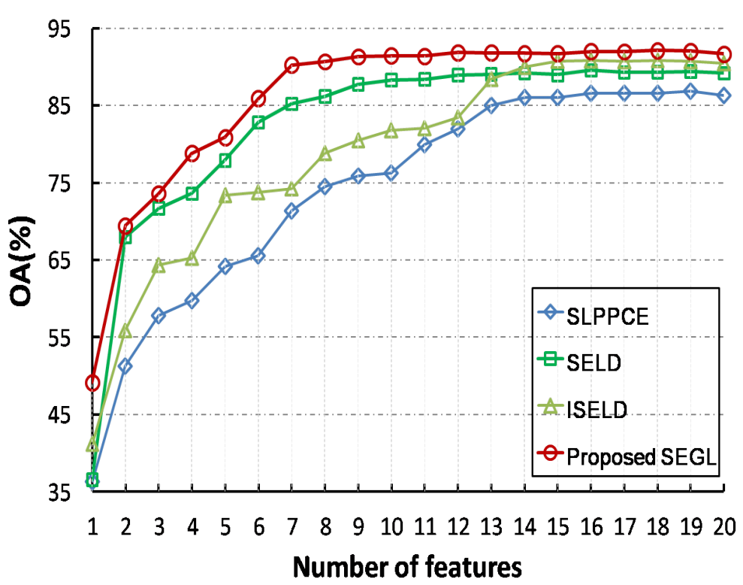
Overall accuracy (OA\%) with the number of extracted features increasing for KSC.

